Slide 1
BRASS Scenario 7
F-35 Testers Wrap up Weapons Delivery Accuracy Tests
Adapted from a flight test that occurred in 2017 in F-35 Lightning flight testing at China Lake, CA

Slide 2
Scenario #7 – Brief Description
This scenario describes a situation that involves two test articles initially sharing the same frequency for their missions. Suddenly TA1 is grounded and leaves the other aircraft (TA2) with more bandwidth for the next 30 minutes.
The goal is for the airborne aircraft (TA2) to take advantage of the extra bandwidth to conduct more tests.

Slide 3
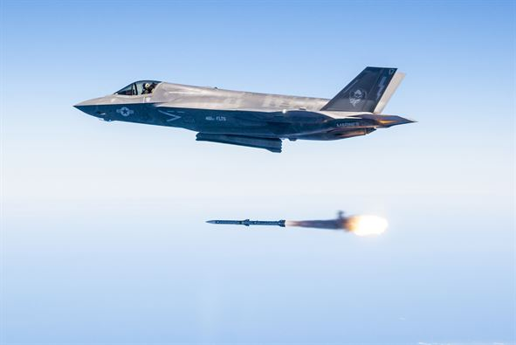

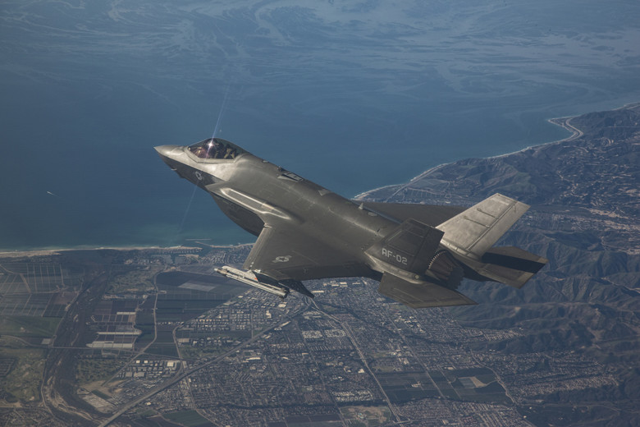
Test Article
Aircraft: F-35
“Each weapon test required multiple missions including software development, “dry runs” and then the actual weapon release. Not including the gun, Hamilton said the F-35 ITF delivered 55 weapons during WDA testing, which was mainly done over the military sea range off the California coast and at Naval Air Weapons Station China Lake in California.”
http://www.hill.af.mil/News/Article-Display/Article/1400908/f-35-testers-wrap-up-weapons-delivery-accuracy-tests/

Slide 4
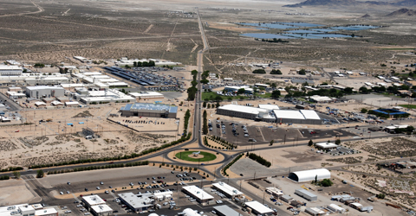
Range Infrastructure
Range Network:
Naval Air Weapon System at China Lake, CA
Equipment Used:
Ground Station Tracking Antenna and related network infrastructure
MCR processing live data
Link Manager
Equipment Available:
All in use
“NAWS China Lake is located in the Western Mojave Desert region of California, approximately 150 miles north of Los Angeles. The installation is the Navy's largest single landholding, representing 85 percent of the Navy’s land for RDAT&E use and 38 percent of the Navy’s land holdings worldwide. In total, its two ranges and main site cover more than 1.1 million acres, an area larger than the state of Rhode Island.”
https://www.cnic.navy.mil/regions/cnrsw/installations/naws_china_lake.html

Slide 5
Flight Test Operation Flow

Slide 6
Dynamic Scheduling
This mission depicts a scenario that contains a Link Manager (LM)
LM is responsible for coordinating the operation of multiple RF Links within a single RF Network
LM utilizes many standardized interfaces defined in IRIG 106-17 Chapters 21 through 28
LM provides a way to dynamically allocate capacity to radio link to achieve desired QoS guarantees
System Manager application provides access to LM and the ability to transmit schedule dynamically for the radios whose links it is managing
Primary operation of LM is to coordinate RF Link control, status, and throughput sharing across multiple RF Links
LM exchanges RF Network Messages (RFNMs) with the link agent interface of each radio associated with the RF Links that the LM manages
Message shapes (IRIG 106-17 Chapters 24)

Slide 7
Associated Constraints
Physical limit on amount of bandwidth that can be achieved
Minimum Capacity used to guarantee transmission of critical data; it must be large enough to accommodate critical data loads
Assured Capacity constraints is the physical amount of the bandwidth; it is its guaranteed capacity if needed; less or = than the physical limit of the bandwidth
Assured Capacity must greater or equal to the minimum capacity

Slide 8
Requirements
Voice, Safety and RFNM (messages between the LM and the Radios) need to be our critical data
LM provides dynamic schedules
Bandwidth available: 10 Mb/s
TA1 is allocated 5 Mb/s
TA2 is allocated 5 Mb/s
When TA1 is grounded then TA2 and LM will need to be reconfigured to reallocate all bandwidth to TA2.
TODO: add latency requirement – 100 ms

Slide 9
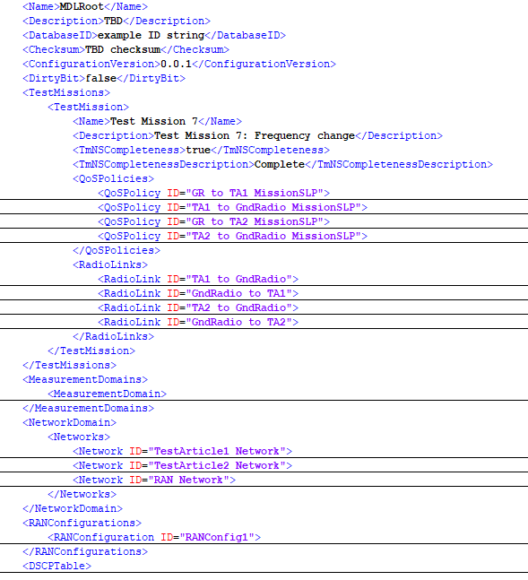
Test Mission Description in MDL
QoSPolicies: Describe the high-level mission-specific data delivery requirements and constraints that will be provided by the Radio Access Network for a given test mission
RadioLinks: Describe the configuration parameters for any Radio Links associated with this test mission
Networks: Describes the physical topology of TA1, TA2 and Ground networks; Describes how everything is connected as well as performance capabilities
RANConfiguration: Describes the set of basic parameters for a Radio Access Network

Slide 10
Network Load Sharing Before Adaptation
TA1 is allocated 5 Mb/s bandwidth – uplink and downlink configuration
Voice: 150Kb/s (75Kb/s downlink and 75Kb/s uplink)
Safety: 100Kb/s (100Kb/s downlink and 0Kb/s uplink)
Bulk: 4,622Kb/s (4,622Kb/s downlink and 0Kb/s uplink)
RFNM: 64Kb/s (32Kb/s downlink and 32Kb/s uplink)

Slide 11
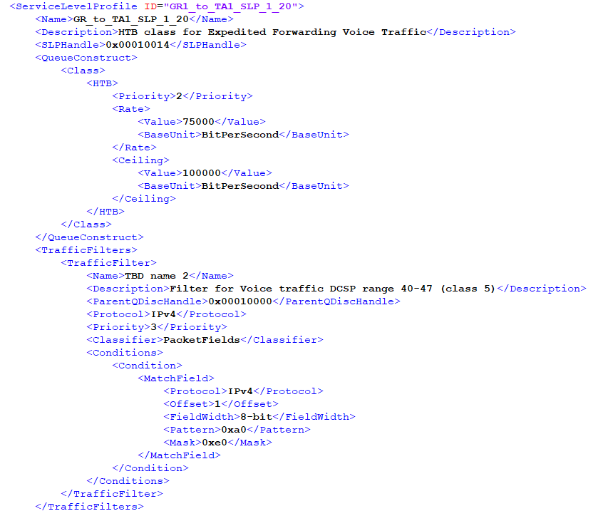
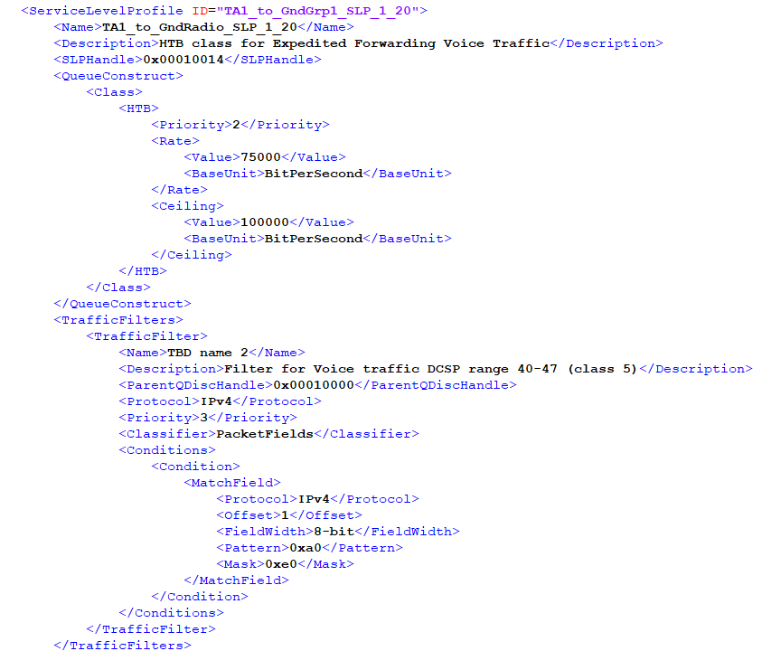
GR/TA1 Uplink and Downlink Voice Traffic Before Adaptation
The rate in the QueueConstruct specifies the rate for that SLP
Ground Radio to TA1 - Uplink Voice Traffic: 75Kb/s
TA1 to Ground Radio - Downlink Voice Traffic: 75Kb/s

Slide 12
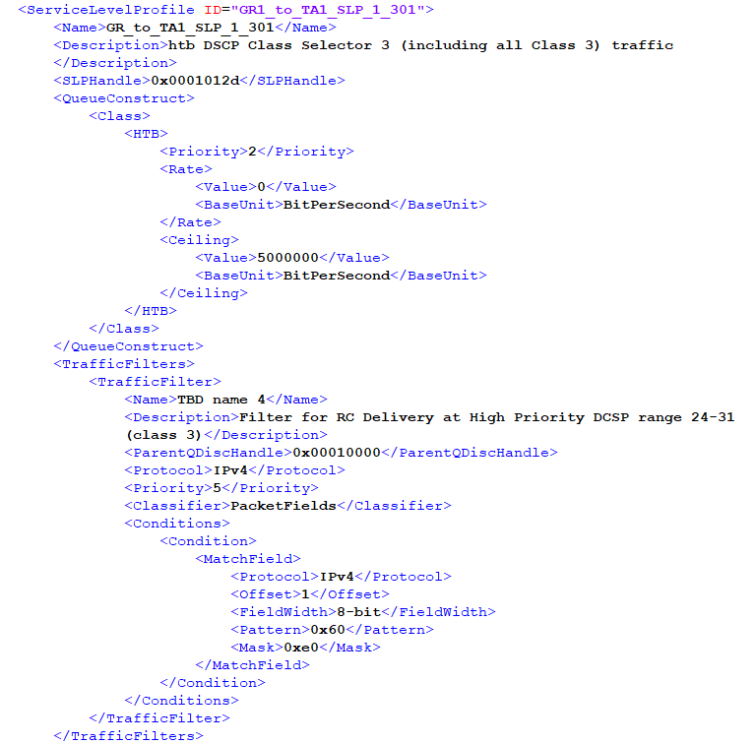
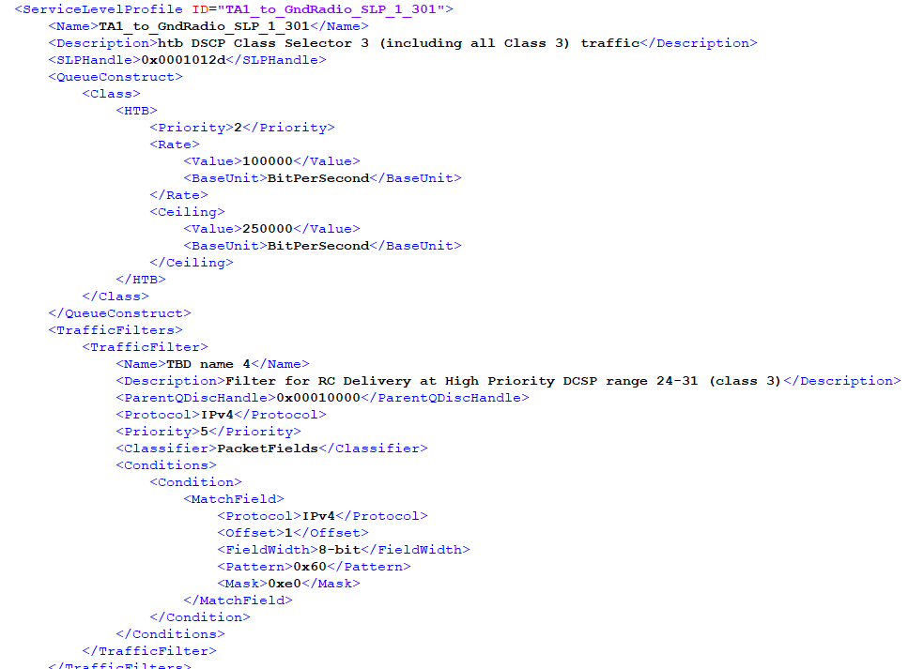
GR/TA1 Uplink and Downlink Safety Traffic Before Adaptation
The rate in the QueueConstruct specifies the rate for that SLP
Ground Radio to TA1 - Uplink Safety Traffic is irrelevant
This traffic is from air to ground only
TA1 to Ground Radio - Downlink Safety Traffic: 100Kb/s

Slide 13
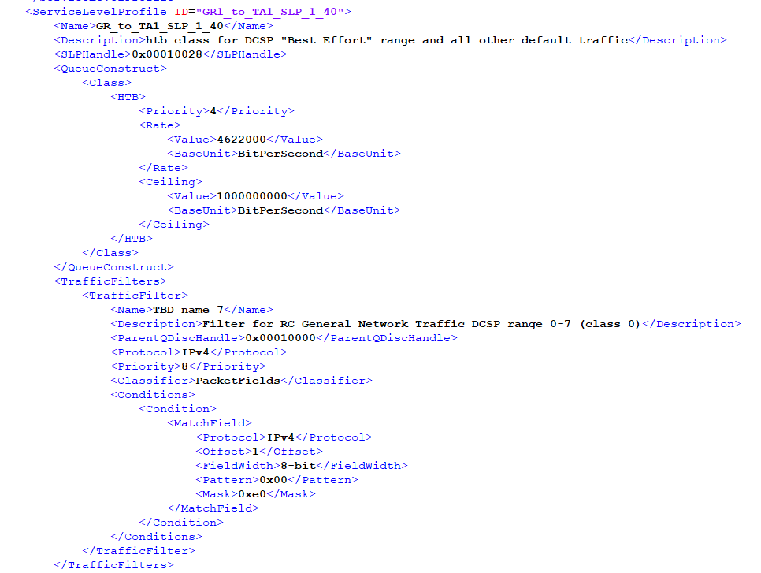
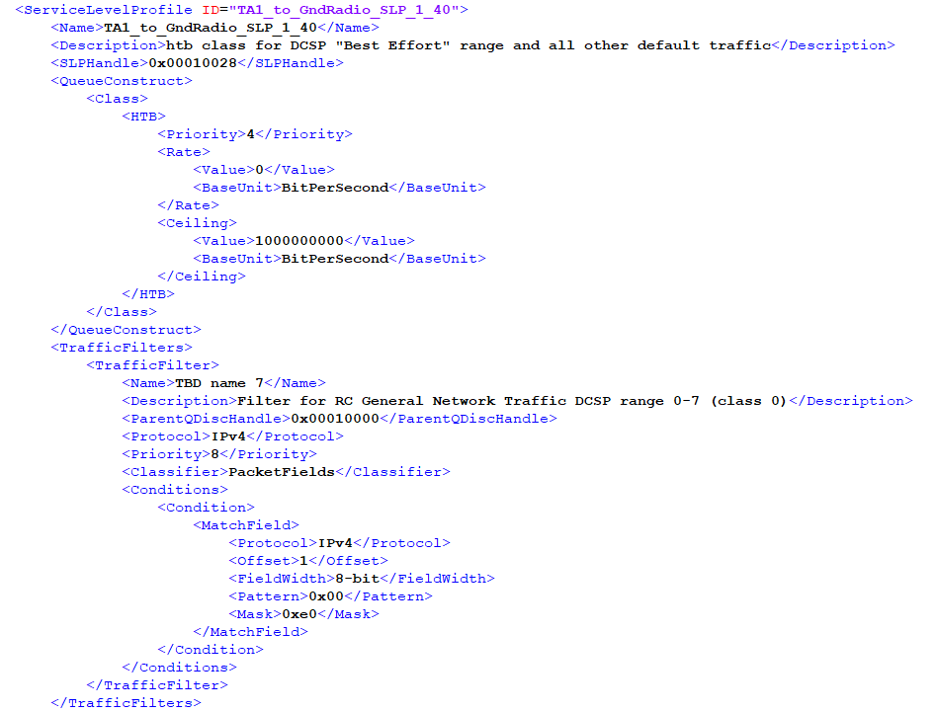
GR/TA1 Uplink and Downlink Bulk Traffic Before Adaptation
The rate in the QueueConstruct specifies the rate for that SLP
Ground Radio to TA1 - Uplink Bulk Traffic: 4622Kb/s
TA1 to Ground Radio - Downlink Bulk Traffic: 0Kb/s

Slide 14
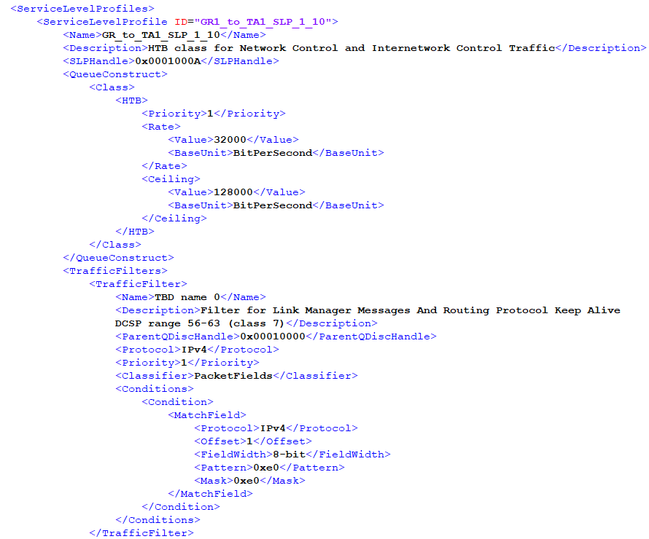
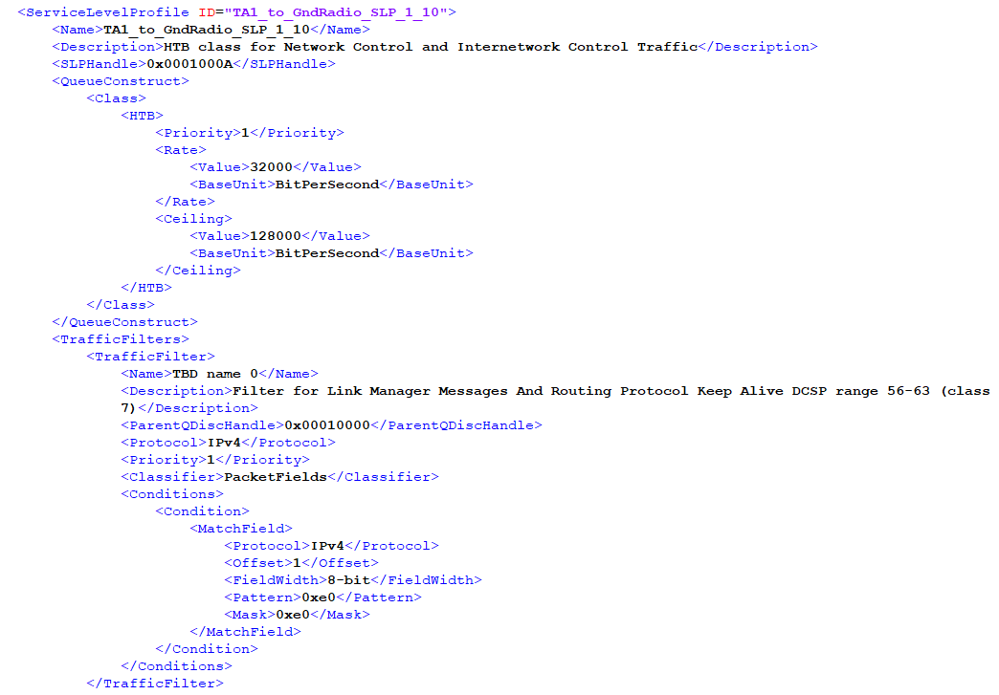
GR/TA1 Uplink and Downlink RFNM Traffic Before Adaptation
The rate in the QueueConstruct specifies the rate for that SLP
Ground Radio to TA1 - Uplink RFNM Traffic: 32Kb/s
TA1 to Ground Radio - Downlink RFNM Traffic: 32Kb/s

Slide 15
Similar for GR/TA2 Uplink and Downlink
TA2 is also using 5 Mb/s bandwidth (for simplification TA2 is using a symmetric use of the network loads)
Voice: 150Kb/s (75Kb/s downlink and 75Kb/s uplink) → critical data
Safety: 100Kb/s (100Kb/s downlink and 0Kb/s uplink) → critical data for downlink
Bulk: 4,622Kb/s (4,622Kb/s downlink and 0Kb/s uplink)
RFNM: 64Kb/s (32Kb/s downlink and 32Kb/s uplink) → critical data

Slide 16
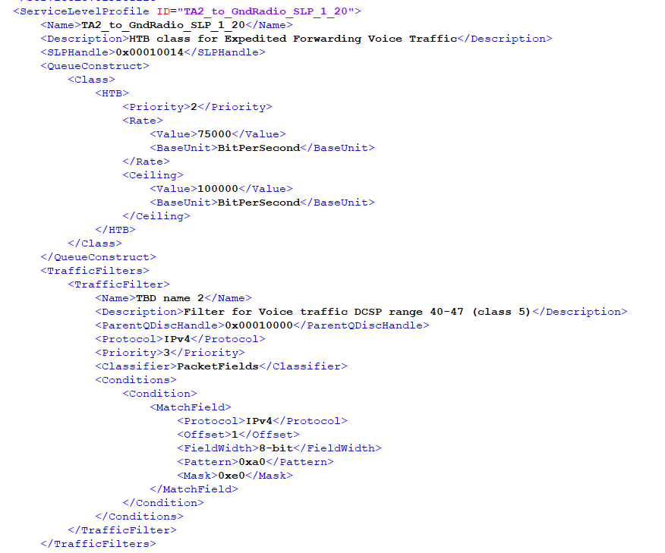
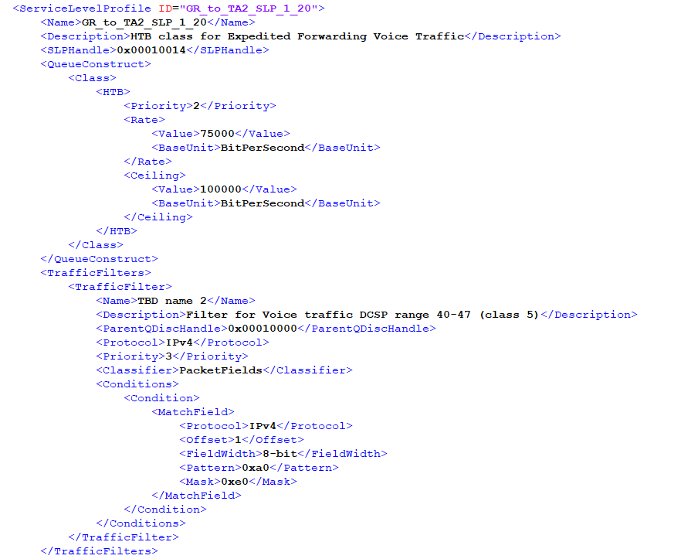
GR/TA2 Uplink and Downlink Voice Traffic Before Adaptation
The rate in the QueueConstruct specifies the rate for that SLP
Ground Radio to TA2 - Uplink Voice Traffic: 75Kb/s
TA2 to Ground Radio - Downlink Voice Traffic: 75Kb/s

Slide 17
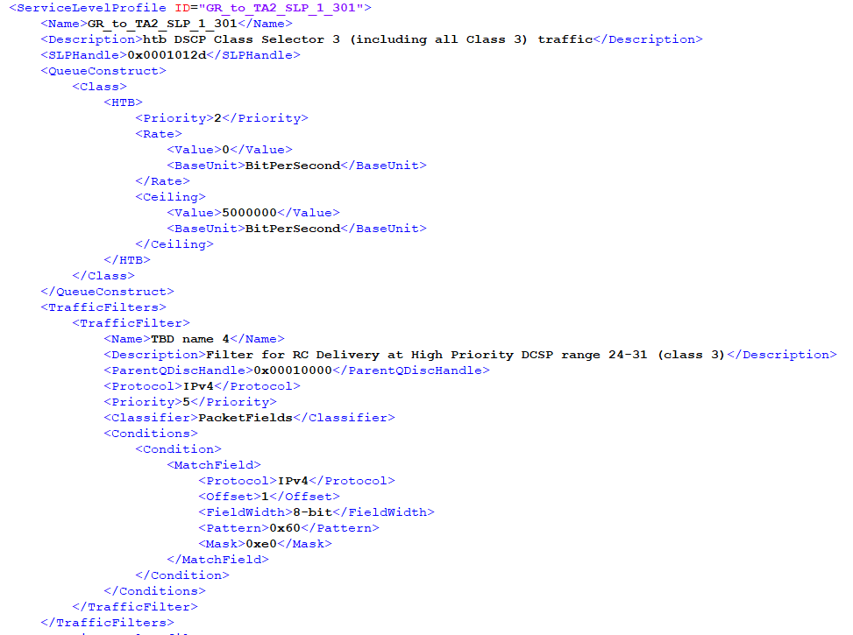
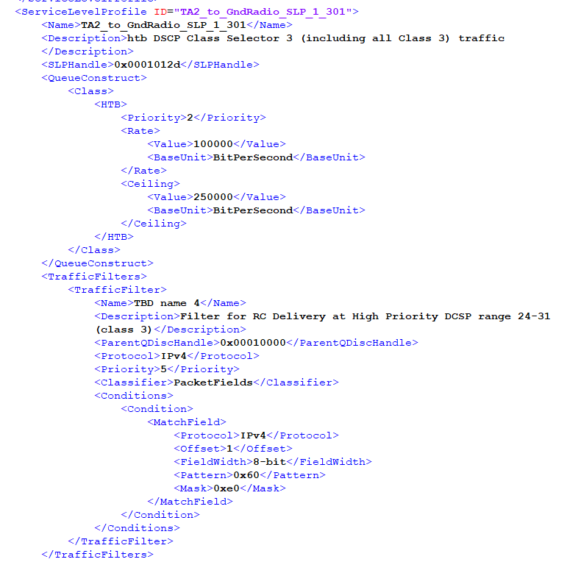
GR/TA2 Uplink and Downlink Safety Traffic Before Adaptation
The rate in the QueueConstruct specifies the rate for that SLP
Ground Radio to TA2 - Uplink Safety Traffic is irrelevant
This traffic is from air to ground only
TA2 to Ground Radio - Downlink Safety Traffic: 100Kb/s

Slide 18
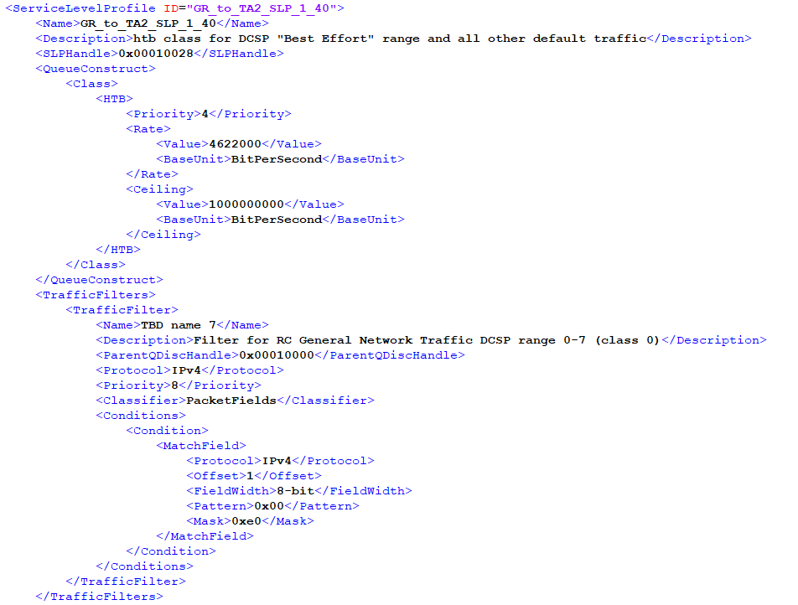
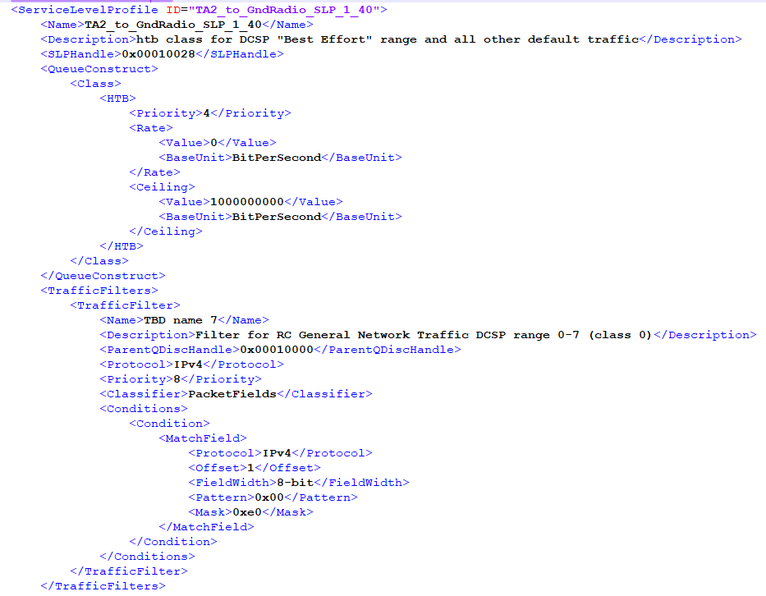
GR/TA2 Uplink and Downlink Bulk Traffic Before Adaptation
The rate in the QueueConstruct specifies the rate for that SLP
Ground Radio to TA2 - Uplink Bulk Traffic: 4622Kb/s
TA1 to Ground Radio - Downlink Bulk Traffic: 0Kb/s

Slide 19
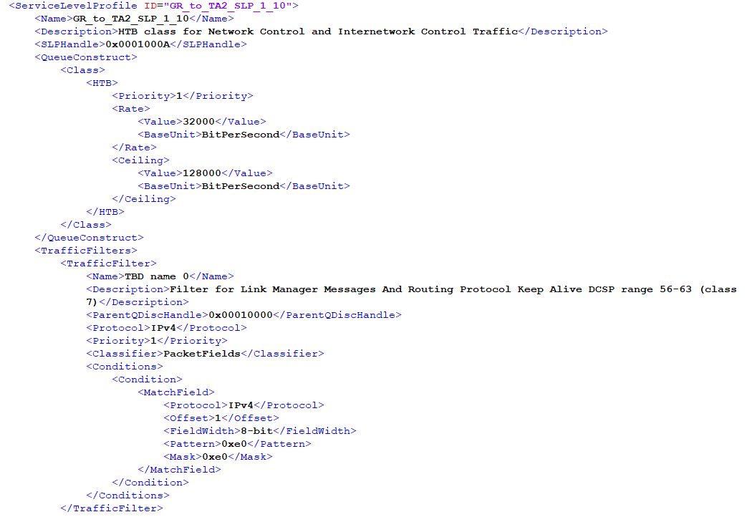
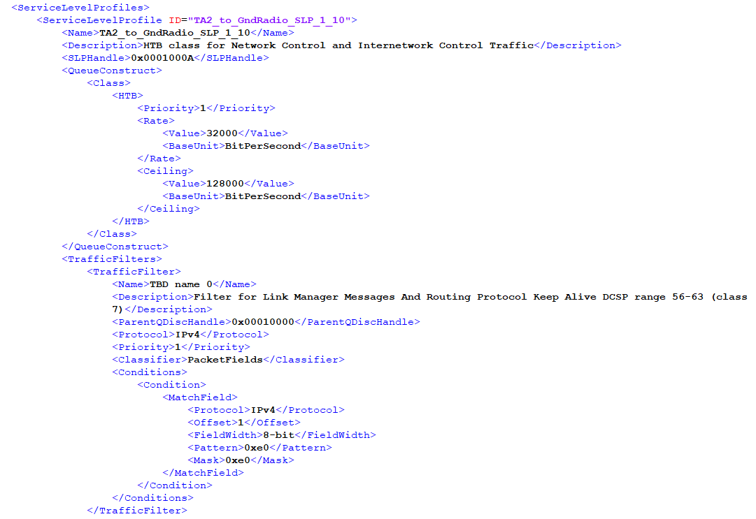
GR/TA2 Uplink and Downlink RFNM Traffic Before Adaptation
The rate in the QueueConstruct specifies the rate for that SLP
Ground Radio to TA2 - Uplink RFNM Traffic: 32Kb/s
TA2 to Ground Radio - Downlink RFNM Traffic: 32Kb/s

Slide 20
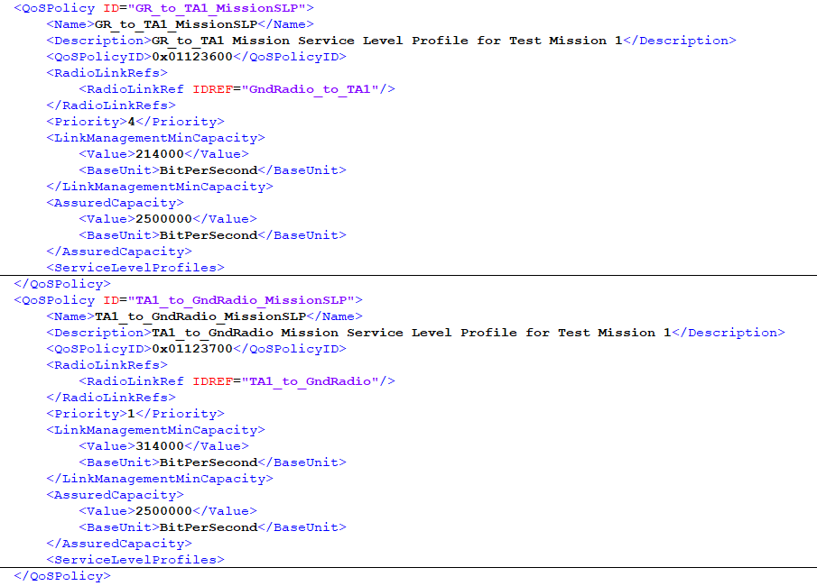
GR/TA1 Assured Capacity
LinkManagementMinCapacity is the sum of the critical data (Safety, Voice and RFNMs)
AssuredCapacity is amount of capacity required by the RF Link under nominal network load

Slide 21
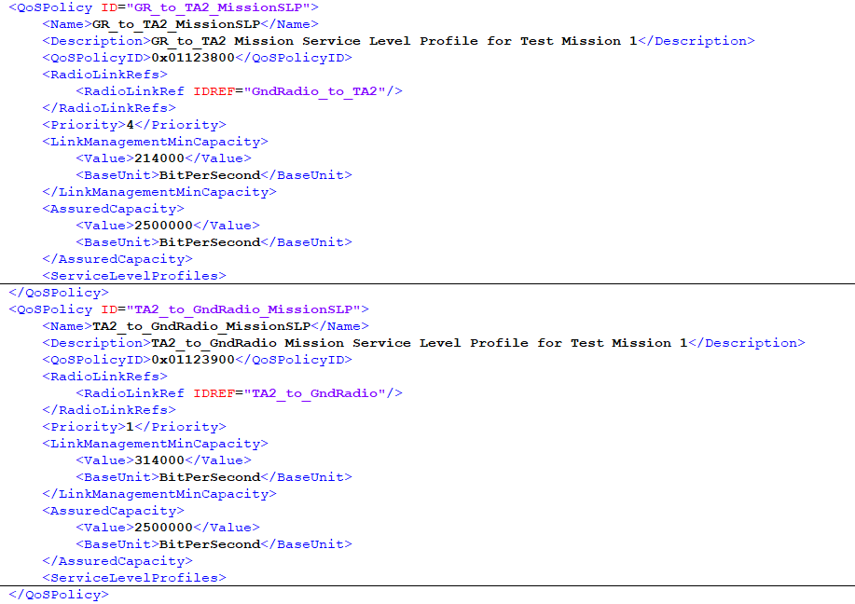
GR/TA2 Assured Capacity
LinkManagementMinCapacity is the sum of the critical data (Safety, Voice and RFNMs)
AssuredCapacity is amount of capacity required by the RF Link under nominal network load

Slide 22
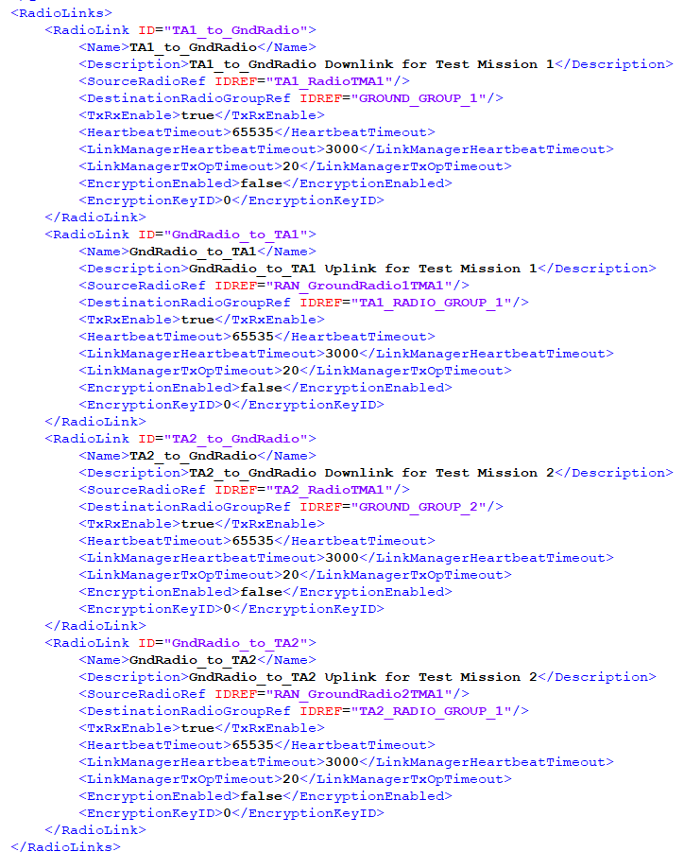
Radio Link Description in MDL
Describes the one way downlink radio link connection between the TA1 radio and the Ground Radio
Describes the one way uplink radio link connection between the Ground Radio and TA1
Describes the one way downlink radio link connection between the TA2 to the Ground Radio
Describes the one way uplink radio link connection between the Ground Radio and TA2
Notes:
<EpochSize>100</EpochSize> in RANConfiguration (per seconds 1000 divide by epoch size)
5 minutes = 300 seconds = 300 * EpochSize = 3,000
2 sec = 2 * EpochSize = 20

Slide 23
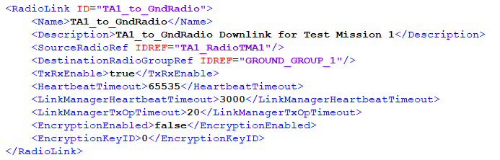
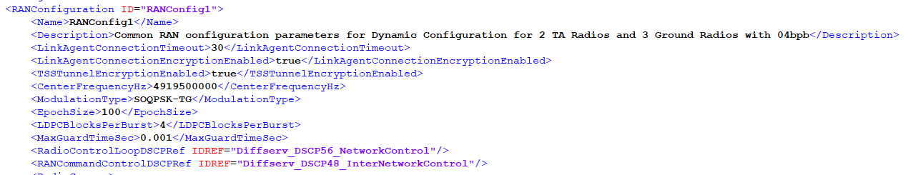
Elements Used to Configure the Link Manager
LinkManagerHeartbeatTimeout The timeout in Epochs to be applied to a Radio that allow it to continue transmitting
This is how LinkManagerHeartbeatTimeout is calculated -- EpochSize is 100
~5min → 300 sec * (1000sec/EpochSize) = 300 * 10 = 3000 Epochs
LinkManagerTxOpTimeout: 2 sec * (1000sec/EpochSize) = 2 * 10 = 20 Epochs
Note: No need for a TransmissionSchedule in this case since we have a dynamic schedule
Notes:
<EpochSize>100</EpochSize> in RANConfiguration (per seconds 1000 divide by epoch size)
5 minutes = 300 seconds = 300 * EpochSize = 3,000
2 sec = 2 * EpochSize = 20

Slide 24
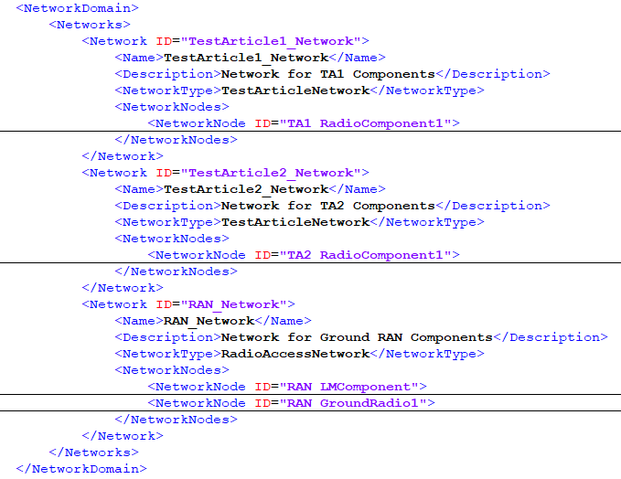
Network Description in MDL
Description of TA1 network which includes a Radio component “TA1_RadioComponent1”
Description of TA2 network which includes a Radio component “TA2_RadioComponent1”
Description of ground network which includes a Link Manager component “RAN_LMComponent” and a ground radio component “RAN_GroundRadio1”

Slide 25
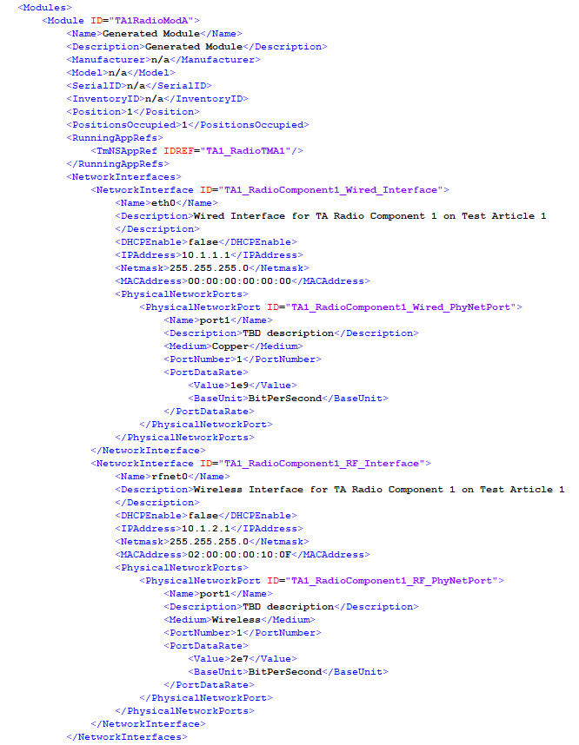
Air Information Bit Rate
This is the air data rate for the radio is a fixed value that we historically used in iNET. It is in the IRIG106-17 Chapter 27
http://www.wsmr.army.mil/RCCsite/_layouts/15/xlviewer.aspx?id=/RCCsite/Documents/References/RAN_Bandwidth_Calculator.xlsx&Source=http%3A%2F%2Fwww%2Ewsmr%2Earmy%2Emil%2FRCCsite%2FPages%2FPublications%2Easpx%3FRootFolder%3D%252FRCCsite%252FDocuments%252FReferences%26FolderCTID%3D0x012000AF4E5B02D5A9F24DA72176DEABA8E665%26View%3D%257B94F84375%252DDEE0%252D43B2%252DBE86%252D97E731BEF435%257D

Slide 26
After TA1 is Grounded
Voice, Safety and RFNM need to be guarantee
Bandwidth available: 10 Mb/s
TA2 can use 10 Mb/s to take advantage of the situation
When TA1 is grounded then TA2 will need to be reconfigured to use the entire bandwidth available 10 Mb/s
System Manager has the role to reconfigure Link Manager to adapt
Dynamic Schedule by Link Manager

Slide 27
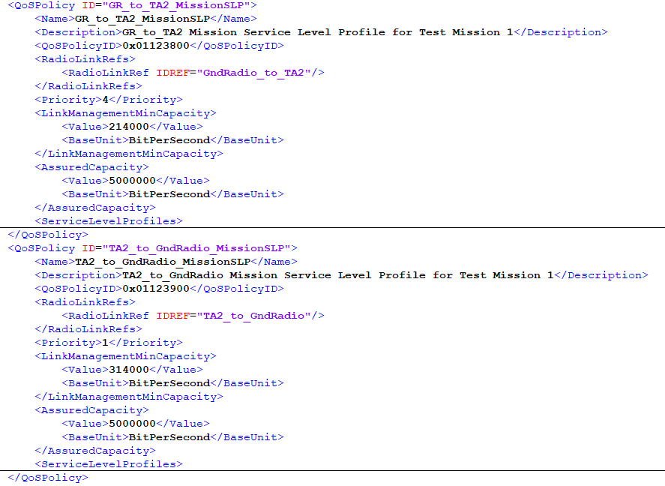
GR/TA2 Assured Capacity Adaptation

Slide 28
Network Load Sharing Adaptation
TA2 is allocated 10 Mb/s bandwidth
Voice: 150Kb/s (75Kb/s downlink and 75Kb/s uplink)
No changes
Safety: 542Kb/s (542Kb/s downlink and 0Kb/s uplink)
We want more safety data sent from TA2 to GR to take advantage of the bandwidth
Bulk: 9,244Kb/s (9,244Kb/s downlink and 0Kb/s uplink)
We want to bring more data down to take advantage of the bandwidth
RFNM: 64Kb/s (32Kb/s downlink and 32Kb/s uplink)
No changes

Slide 29
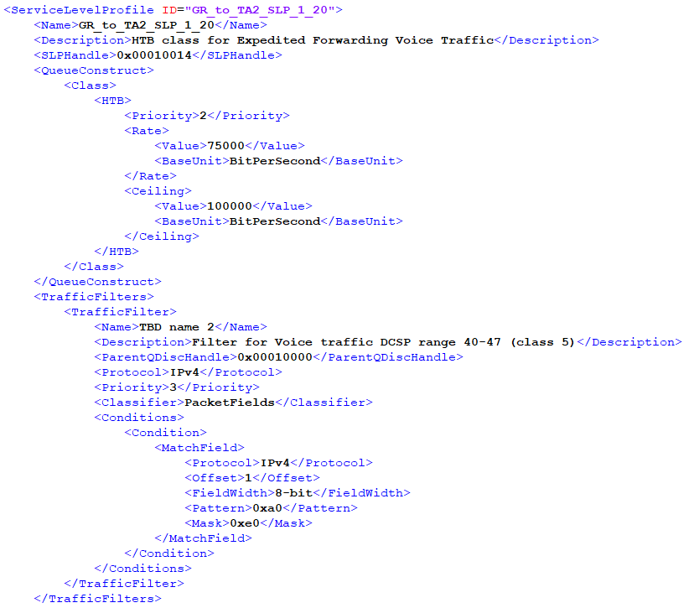
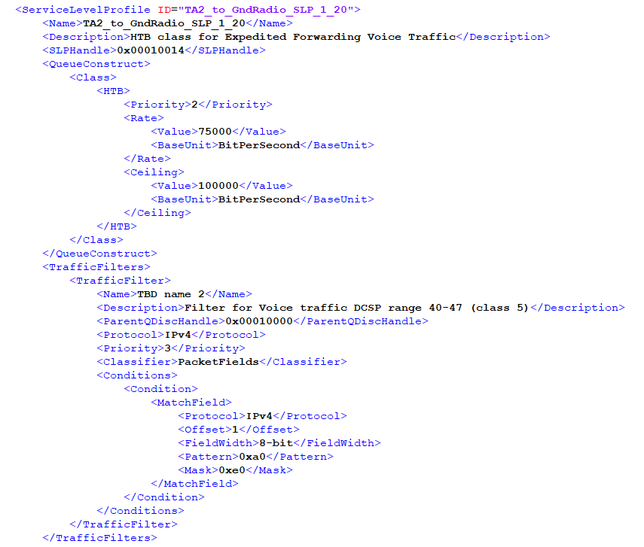
GR/TA2 Uplink and Downlink Voice Traffic Adaptation
The rate in the QueueConstruct specifies the rate for that SLP
Ground Radio to TA2 - Uplink Voice Traffic: 150Kb/s
TA2 to Ground Radio - Downlink Voice Traffic: 150Kb/s

Slide 30
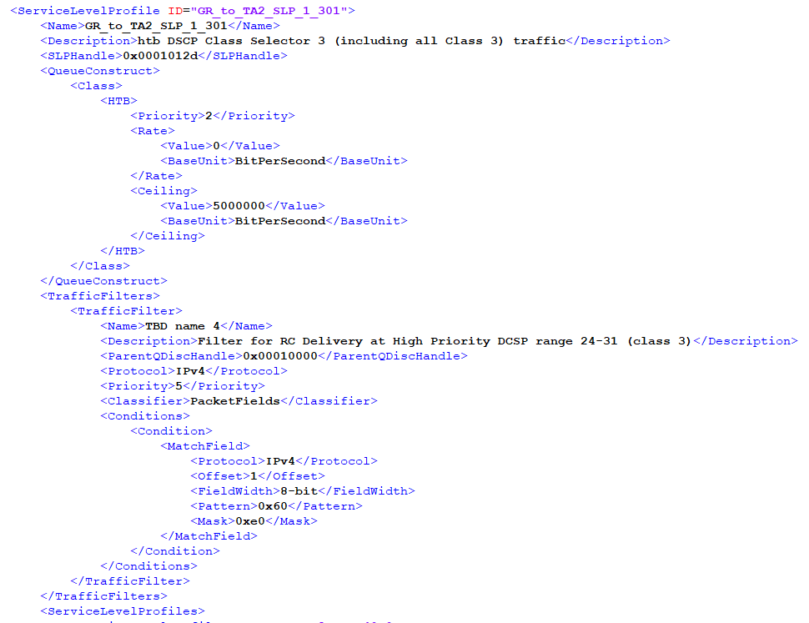
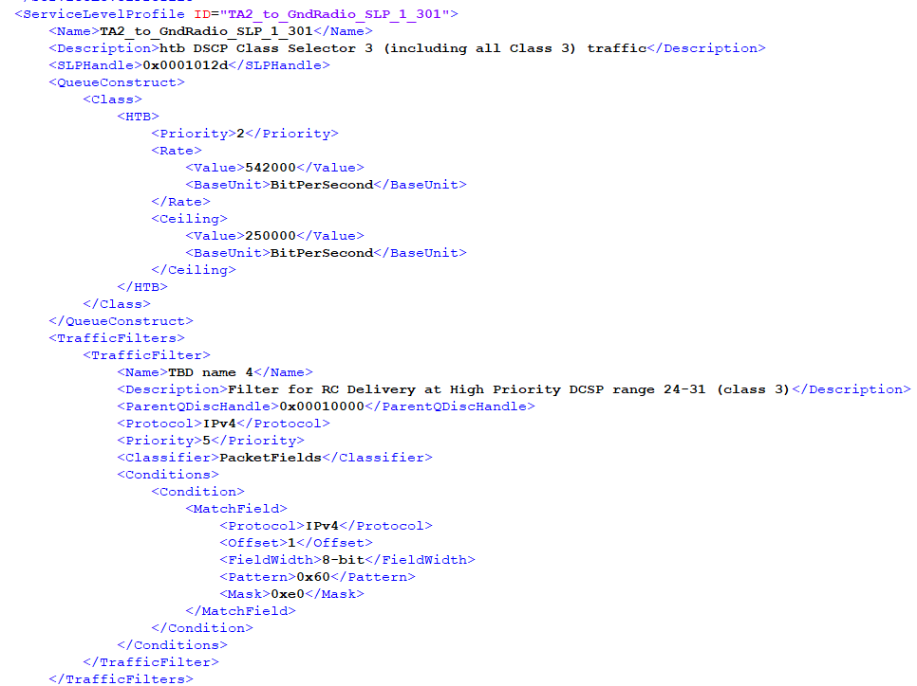
GR/TA2 Uplink and Downlink Safety Traffic Adaptation
The rate in the QueueConstruct specifies the rate for that SLP
Ground Radio to TA1 - Uplink Safety Traffic is irrelevant
This traffic is from air to ground only
TA1 to Ground Radio - Downlink Safety Traffic: 542Kb/s

Slide 31
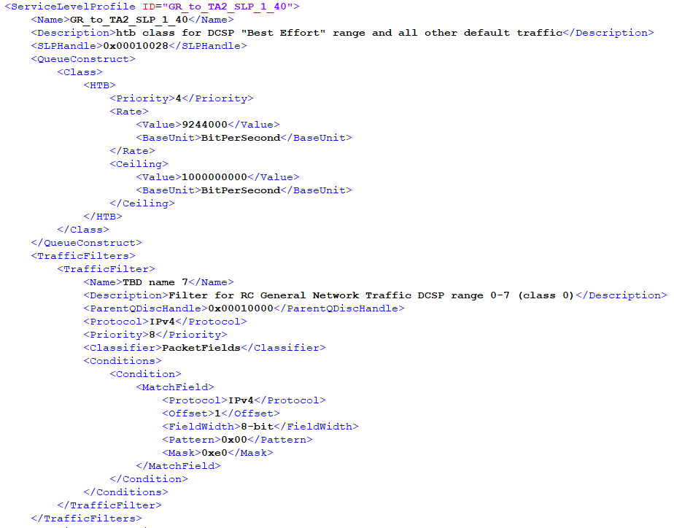

GR/TA2 Uplink and Downlink Bulk Traffic Adaptation
The rate in the QueueConstruct specifies the rate for that SLP
Ground Radio to TA2 - Uplink Bulk Traffic: 9,244Kb/s
TA2 to Ground Radio - Downlink Bulk Traffic: 0Kb/s

Slide 32
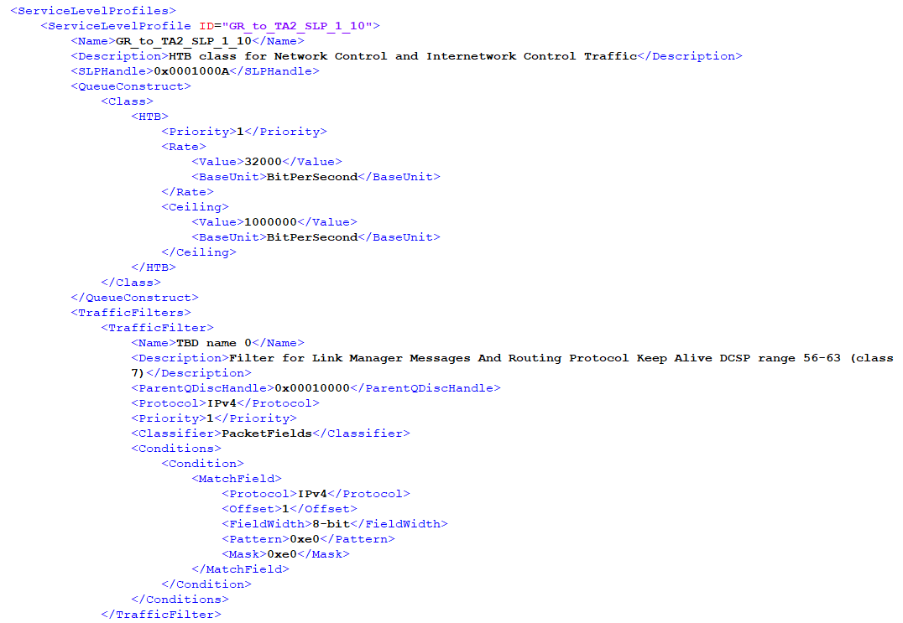
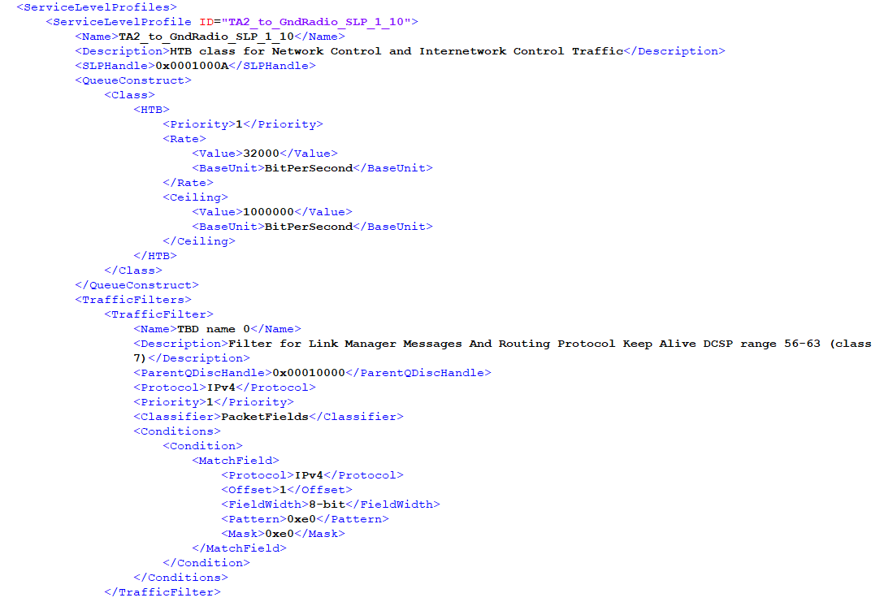
GR/TA2 Uplink and Downlink RFNM Traffic Adaptation
The rate in the QueueConstruct specifies the rate for that SLP
Ground Radio to TA2 - Uplink RFNM Traffic: 32Kb/s
TA2 to Ground Radio - Downlink RFNM Traffic: 32Kb/s

